Slide 1
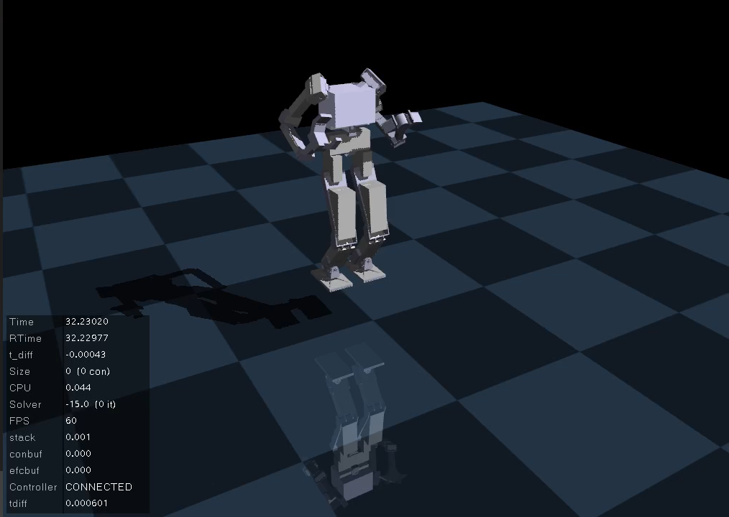
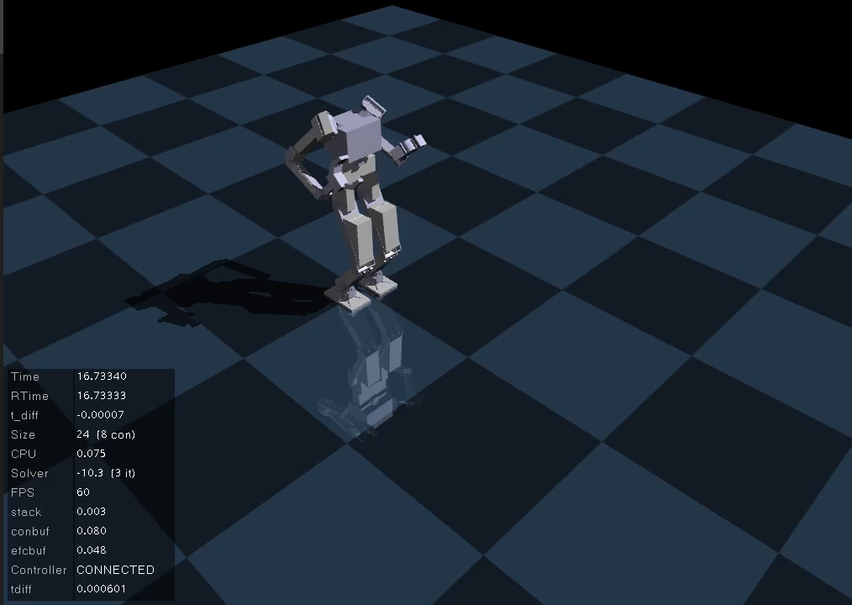
HW#4 simulation video
Walking in the air
Walking on the ground

Slide 2
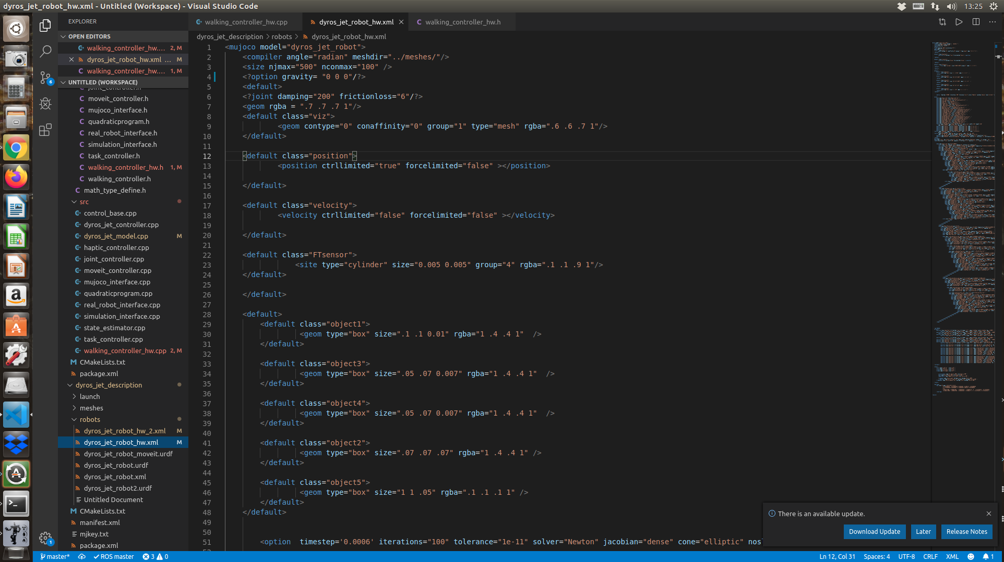
How to land Robot on the ground
Write “?” at the right to the “<“ and left to the “>” and save with ctrl+s
(ignore the settings of gravity = 0)
File location : Home/catkin_ws/src/dyros_jet/dyros_jet_description/robots/ dyros_jet_robot_hw.xml

